Slide 1
Topic 1
Fundamentals of the Analysis of Algorithm Efficiency
Prof. Hanan Elazhary
Main source: A. Levitin, Introduction to the Design and Analysis of Algorithms, 3rd edition

Slide 2
What is an algorithm?
An algorithm is a sequence of unambiguous instructions for solving a problem, i.e., obtaining the required output for any legitimate input in a finite amount of time
problem
algorithm
“computer”
input
output

Slide 3
What is an algorithm?, Contd.
Properties of an algorithm
Representable in various forms
Unambiguity/clearness
Correctness
Finiteness/termination
Effectiveness

Slide 4
Historical Perspective
Muhammad ibn Musa al-Khwarizmi – 9th century mathematician
www.lib.virginia.edu/science/parshall/khwariz.html
The word ‘algorism’ (originally) and later ‘algorithm’ come from his name
Euclid’s algorithm for finding the greatest common divisor (of two or more numbers) is good for introducing the notion of an algorithm
Notes:
gcd(a, b, c) = gcd(a, gcd(b, c)) = gcd(gcd(a, b), c) = gcd(gcd(a, c), b)

Slide 5
Euclid’s Algorithm
Problem
Find gcd(m,n), the greatest common divisor of two nonnegative, not both zero integers m and n
e.g., gcd(60,24) = 12 and gcd(60,0) = 60
Euclid’s algorithm is based on repeated application of the equality
gcd(m,n) = gcd(n, m mod n)
until the second number becomes 0, which makes the problem trivial
e.g., gcd(60,24) = gcd(24,12) = gcd(12,0) = 12
gcd(0,0) = ?
Notes:
Mod is the remainder
gcd(0, 0) is undefined; all integers are common divisors of 0 and 0

Slide 6
Euclid’s Algorithm, Contd.
Two descriptions of Euclid’s algorithm
Step 1 If n = 0, return m and stop; otherwise go to Step 2.
Step 2 Divide m by n and assign the value of the remainder to r (temporary variable).
Step 3 Assign the value of n to m and the value of r to n. Go to Step 1.
while n ≠ 0 do
r ← m mod n
m ← n
n ← r
return m
gcd(m,n)

Slide 7
Analysis of Algorithms
Issues
correctness
time efficiency (how fast)
space efficiency (how much memory required)
optimality
Approaches
theoretical (mathematical) analysis
empirical analysis
algorithm visualization

Slide 8
Theoretical Analysis of Time Efficiency

Slide 9
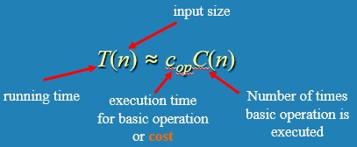
Theoretical Analysis of Time Efficiency
Time efficiency (running time estimate) is a function of input size
It is analyzed by determining the count of the basic operation of the algorithm (number of repetitions)
The basic operation is the one that contributes the most towards the running time of the algorithm (typically, it is the most time-consuming operation in the algorithm’s innermost loop)
Note that different basic operations may give different results!
Notes:
Specify n, basic operation, and C(n)

Slide 10
Input Size and Basic Operation Examples
Problem | Input size | Basic operation
Searching for a key in a list of n items | Number of list’s items, i.e., n | Comparison of the key
Multiplication of two matrices | Matrix dimensions or total number of elements | Multiplication of two numbers
Checking primality of a given integer n (can only be divided by itself or by 1) | Size of n = number of digits in binary representation | Division
Typical graph problem | Number of vertices and/or edges | Visiting a vertex or traversing an edge

Slide 11
Basic Operation Count Worst, Best and Average Cases
For some algorithms, the time efficiency can be different for different inputs of the same size (due to difference in basic operation count)
Worst case: Cworst(n) – maximum over inputs of size n
Best case: Cbest(n) – minimum over inputs of size n
Average case: Cavg(n) – average over inputs of size n
Average refers to basic operation count required for an input (of size n), on average
NOT the average of worst and best cases
Notes:
Specify n, basic operation, cases, and C(n)

Slide 12
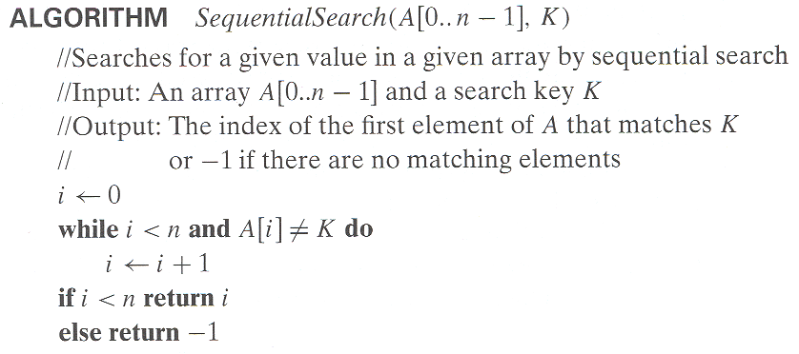
Example: Sequential/Linear Search
Worst case:
Best case:
Average case:
n comparisons
Based on the sum of natural numbers, (1+2+3+….+N)/N = (N(N+1)/2)/N = (N+1)/2
1 comparison, assuming K is in A
(n+1)/2 comparisons, assuming K is in A

Slide 13
Types of Formulas for Basic Operation Count
Exact formula
e.g., C(n) = n(n-1)/2
Formula indicating order of growth with specific multiplicative constant
e.g., C(n) ≈ 0.5n²
Formula indicating order of growth with unknown multiplicative constant
e.g., C(n) ≈ cn²
Notes:
Specify n, basic operation, cases, and C(n) which may be approximate

Slide 14
Types of Formulas for Basic Operation Count. Contd.
Order of growth of an algorithm indicates how slow/fast the algorithm will change if the input size is changed
For example, if the order of growth is cn²
How much faster will the algorithm run on a computer that is twice as fast?
How much longer does it take to solve the problem with double input size?
taking into consideration that
for small values of n, the order of growth does not really matter
for large values of n, the order of growth is defined within a constant multiple as n→∞
Notes:
2, 4

Slide 15
Types of Formulas for Basic Operation Count. Contd.
Order of growth of an algorithm indicates how slow/fast the algorithm will change if the input size is changed
For example, if the order of growth is cn²
How much faster will the algorithm run on a computer that is twice as fast?
T(n)=c/2​ n²
How much longer does it take to solve the problem with double input size?
T(2n)=c(2n)²=4cn²
taking into consideration that
for small values of n, the order of growth does not really matter
for large values of n, the order of growth is defined within a constant multiple as n→∞
Notes:
2, 4

Slide 16
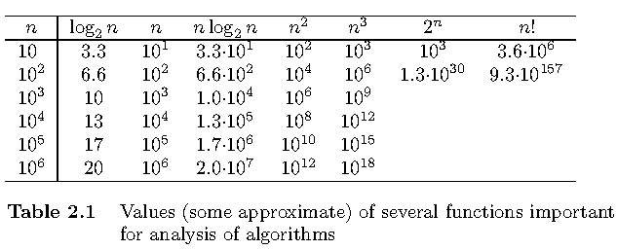
Values of Some Important Functions as n→∞
indicating the order of growth

Slide 17
Asymptotic Order of Growth of an Algorithm
A way of comparing functions that ignores small input sizes and constant factors (because?)
t(n) is in O(g(n))
class of functions t(n) that grow no faster than g(n) (<=)
f(n) is in Ω(g(n)) - omega
class of functions t(n) that grow at least as fast as g(n) (>=)
t(n) is in Θ(g(n)) - theta
class of functions t(n) that grow at same rate as g(n) (=)
Notes:
Start at n₀ since for small values of n, the order of growth does not really matter
Ignore any constant factor when considering g(n) since computing the ratio of two points along the function would cancel the constant factor

Slide 18
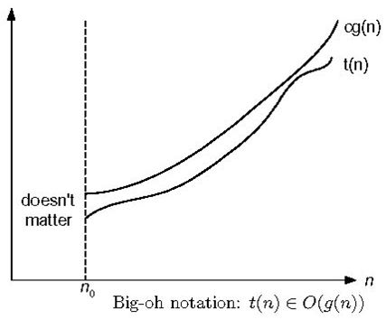
O-notation
Definition
t(n) is in O(g(n)), denoted t(n) ∈ O(g(n)), if t(n) is bounded above by some constant multiple of g(n) for all large n, i.e., there exist some positive constant c and some non-negative integer n₀ such that t(n) ≤ c g(n) for every n ≥ n₀
Examples
10n ∈ O(n²)
10n ≤ 10n² for n ≥ 1 or 10n ≤ n² for n ≥ 10
5n+20 ∈ O(n)
5n+20 ≤ 10n for n ≥ 4
order of growth of t(n) ≤ order of growth of g(n) within a constant multiple
Notes:
means belongs to

Slide 19
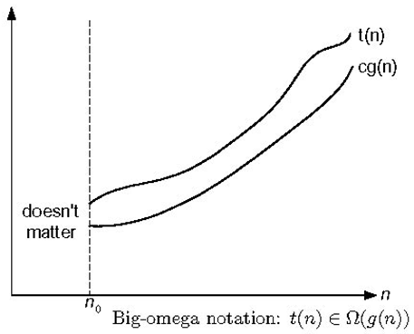
Ω-notation
Definition
t(n) is in Ω(g(n)), denoted t(n) ∈ Ω(g(n)), if t(n) is bounded below by some constant multiple of g(n) for all large n, i.e., there exist some positive constant c and some non-negative integer n₀ such that t(n) ≥ c g(n) for every n ≥ n₀
Exercises: prove the following
10n² ∈ Ω(n²)
0.3n² - 2n ∈ Ω(n²)
0.1n³ ∈ Ω(n²)

Slide 20
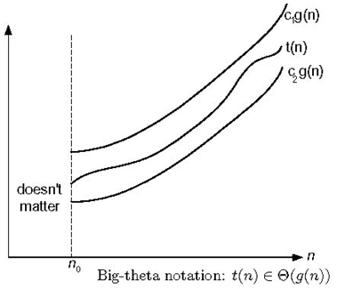
Θ-notation
Definition
t(n) is in Θ(g(n)), denoted t(n) ∈ Θ(g(n)), if t(n) is bounded both above and below by some constant multiples of g(n) for all large n, i.e., there exist some positive constants c₁ and c₂ and some non-negative integer n₀ such that c₂ g(n) ≤ t(n) ≤ c₁ g(n) for every n ≥ n₀
Exercises: prove the following
10n² ∈ Θ(n²)
0.3n² - 2n ∈ Θ(n²)
(1/2)n(n+1) ∈ Θ(n²)

Slide 21
Summary of Notations
>=
Ω(g(n)), functions that grow at least as fast as g(n)
=
Θ(g(n)), functions that grow at the same rate as g(n)
g(n)
<=
O(g(n)), functions that grow no faster than g(n)

Slide 22
Basic Asymptotic Efficiency Classes
1 | constant
log n | logarithmic
n | linear
n log n | n-log-n (linearithmic)
n² | quadratic
n³ | cubic
2^{n} | exponential
n! | factorial

Slide 23
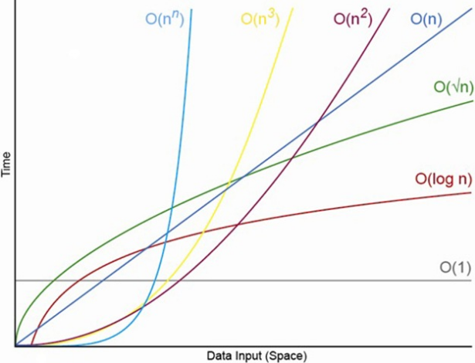
Basic Asymptotic Efficiency Classes, Contd.

Slide 24

More on Asymptotic Order of Growth, Contd.
All polynomials of the same degree k belong to the same class
All logarithmic functions log_{a} n belong to the same class Θ(log n) no matter what the logarithm’s base a > 1 is because
Exponential functions a^{n} can have different orders of growth for different a’s
log_{b}a is a constant

Slide 25
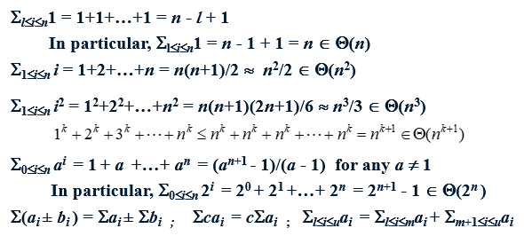
Useful Summation Formulas and Rules
25

Slide 26

Important Definitions and Theorems
f(n) is called eventually nondecreasing if
f(n) is a nonnegative function
defined on the set of natural numbers
and
The vast majority of functions we encounter in the analysis of algorithms are eventually nondecreasing
Most of them are, in fact, nondecreasing on their entire domains

Slide 27

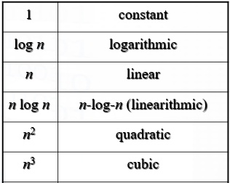
Important Definitions and Theorems, Contd.
f(n) is called smooth if
it is eventually non decreasing
and
Functions which do not grow too fast are smooth
1, log n, n, n log n, and n^{α} where α ≥ 0 are smooth

Slide 28
Important Definitions and Theorems, Contd.
The Smoothness Rule
If T(n) is eventually nondecreasing (such as the vast majority of functions we encounter in the analysis of algorithms)
and g(n) is a smooth function (such as 1, log n, n, n log n, and n^{α} where α ≥ 0)
and
T(n) ∈ Θ(g(n)) for n = b^{k}, b≥2
then
T(n) ∈ Θ(g(n)) for any n
Similar results hold for the O and Ω notations
we can prove for n = b^{k} (such as n = 2^{k}), and generalize to any n
Notes:
Remember that Theta implies Big O and Omega

Slide 29
Time Efficiency of Non-Recursive Algorithms
General Plan for Analysis
Decide on parameter n indicating input size
Identify algorithm’s basic operation
Determine worst, average, and best cases for input of size n
Set up a sum for the number of times the basic operation is executed (basic operation count)
Simplify the sum using standard formulas and rules (see Appendix A)

Slide 30
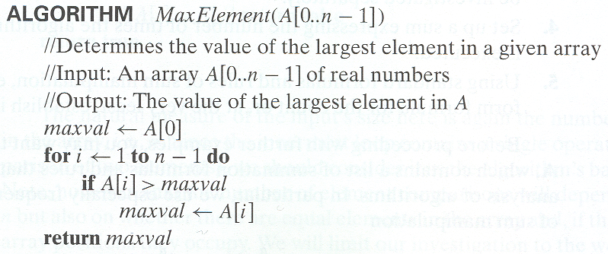
Example 1: Maximum Element
C(n) = Σ_{1≤i≤n-1} 1 = n-1 ∈ Θ(n) comparisons

Slide 31
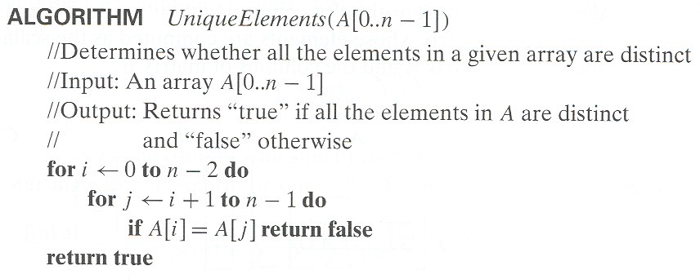
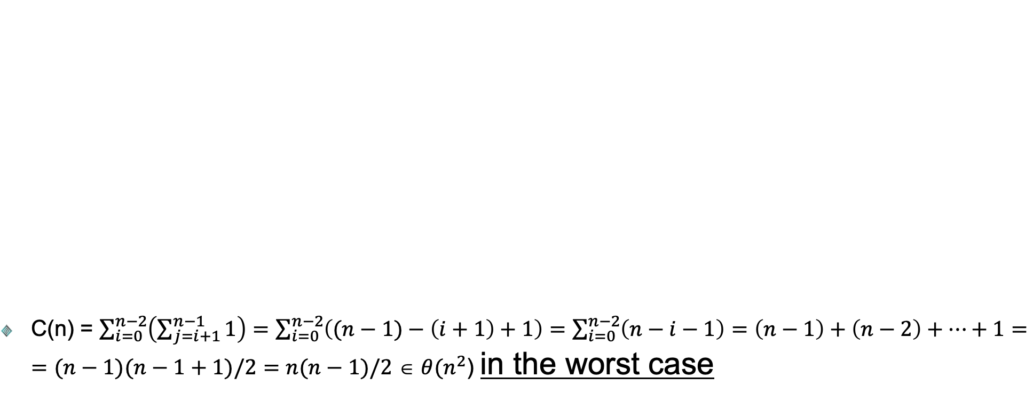
Example 2: Element Uniqueness Problem
C(n) = $\sum_{i=0}^{n−2}{\left(\sum_{j=i+1}^{n−1}{1}\right)}=\sum_{i=0}^{n−2}{\left((n−1)−\left(i+1\right)+1\right)=\sum_{i=0}^{n−2}{\left(n−i−1\right)=\left(n−1\right)+\left(n−2\right)+…+1}=}$ $=(n−1)(n−1+1)/2=n(n−1)/2$ ∈ $θ(n^{2}$) in the worst case
Notes:
∈ O$(n^{2}$) in general

Slide 32
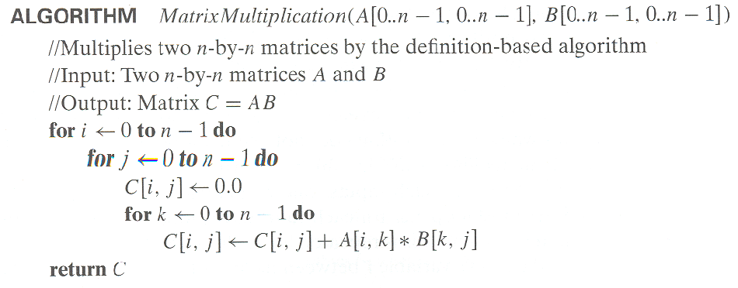
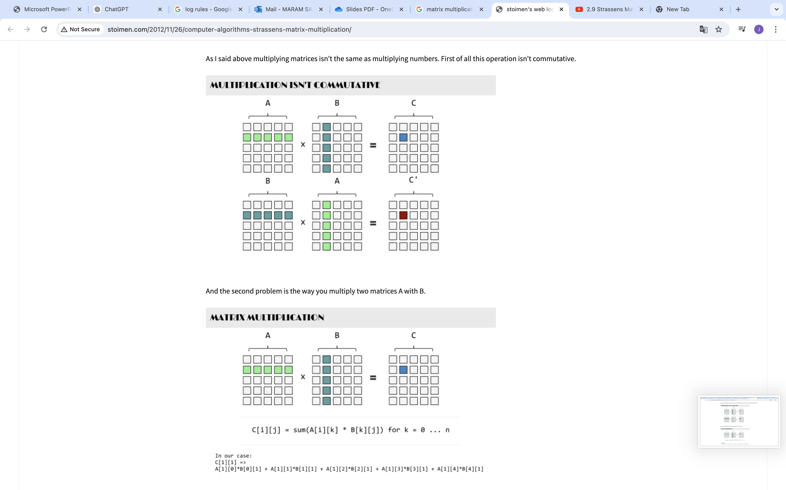
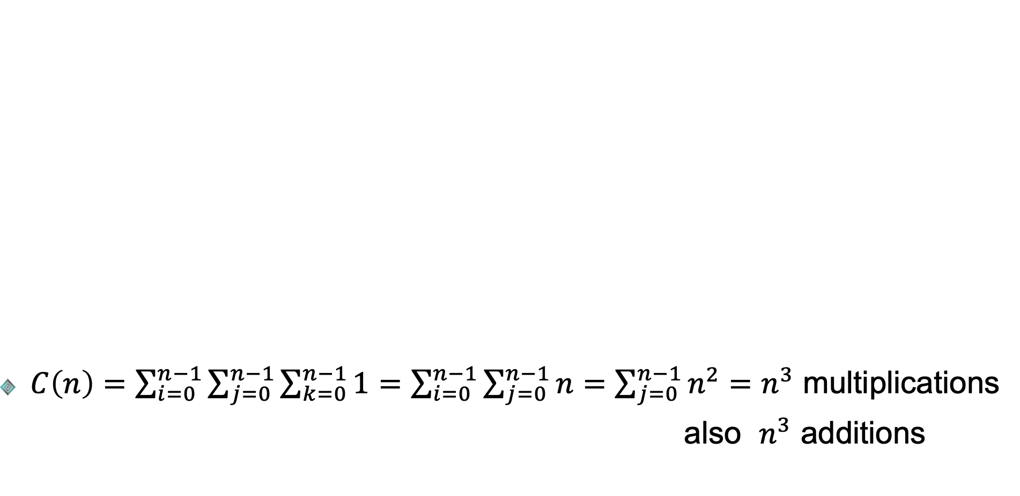
Example 3: Matrix Multiplication
$C\left(n\right)=\sum_{i=0}^{n−1}{\sum_{j=0}^{n−1}{\sum_{k=0}^{n−1}{1}}}=\sum_{i=0}^{n−1}{\sum_{j=0}^{n−1}{n}}=\sum_{j=0}^{n−1}{n^{2}}=n^{3}$ multiplications
also $n^{3}$ additions

Slide 33
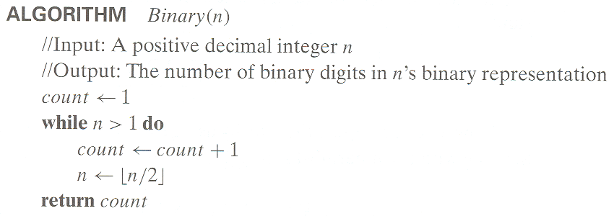
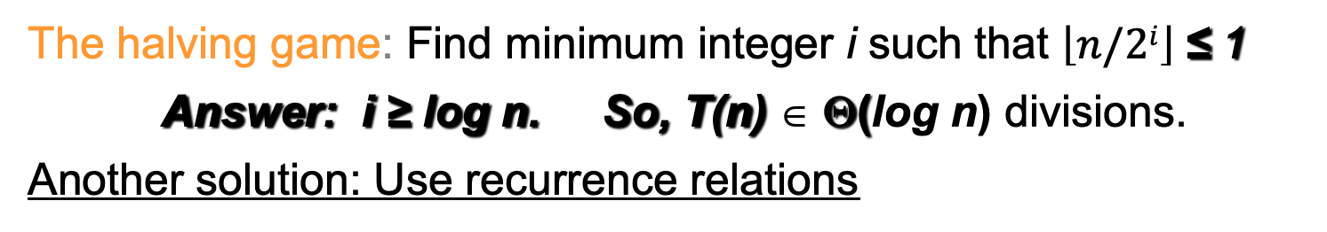

Example 4: Counting Binary Digits (Bits)
$\text{Input} \text{size} \text{is} \text{n}\text{, }\text{basic} \text{operation} \text{is} \text{division}\text{, }\text{one} \text{case}$
$It cannot be investigated the way the previous examples are$
For integer 1: 0 division, one bit
For integers > 1:
add the initial bit
add another bit and divide by two taking the floor (one bit per division)
repeat until you get 1
i divisions in total indicate a total of i+1 bits
The halving game: Find minimum integer i such that $\left\lfloor n/2i\right\rfloor$≤ 1
Answer: i ≥ log n. So, T(n) ∈ Θ(log n) divisions.
Another solution: Use recurrence relations
Notes:
Here we look at divisions knowing that the count of the bits is higher by one

Slide 34
Time Efficiency of Recursive Algorithms
General Plan for Analysis
Decide on a parameter indicating an input’s size.
Identify the algorithm’s basic operation.
Check whether the number of times the basic op. is executed may vary on different inputs of the same size (If it may, the worst, average, and best cases must be investigated separately)
Set up a recurrence relation with an appropriate initial condition expressing the number of times the basic operation is executed.
Solve the recurrence (or, at the very least, establish its solution’s order of growth) by backward substitutions or another method.

Slide 35
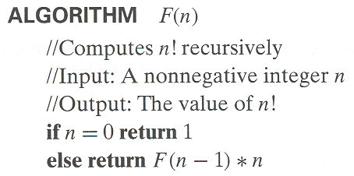
Example 1: Recursive Evaluation of n!
Definition of n ! = 1 ∗ 2 ∗ … ∗(n-1) ∗ n for n ≥ 1 and 0! = 1
Recursive definition of n!: F(n) = F(n-1) ∗ n for n ≥ 1 and F(0) = 1
Size: n
Basic operation: multiplication
Recurrence relation (number of multiplications made by this algorithm): M(n) = M(n-1) + 1 and M(0) = 0
Base case
Recursive case

Slide 36
Example 1: Contd.
Solving the recurrence for M(n)
M(n) = M(n-1) + 1, M(0) = 0
M(n) = M(n-1) + 1
= (M(n-2) + 1) + 1 = M(n-2) + 2
= (M(n-3) + 1) + 2 = M(n-3) + 3
…
= M(n-i) + i When n-i=0 =>i=n
=M(n-n) + n
= M(0) + n
= n
The method is called backward substitution

Slide 37
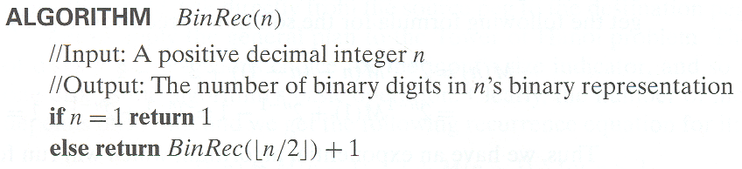
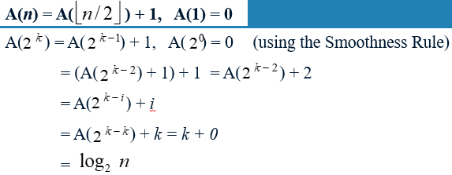
Example 3: Counting Binary Digits (Bits)
Input size is n, basic operation is addition of a bit, one case
Trying to apply the smoothness rule n = 2^{k}
n = 2^{k}, k = log n
Notes:
Here we look at the additions of bits that form the recursion

Slide 38
Complexity Classes
Complexity classes:
P (polynomial)
NP (non-deterministic polynomial)
NP-complete
NP-hard
Introduction to the design and analysis of algorithms, Levitin, 3rd edition, 2011

Slide 39
Empirical Analysis of Time Efficiency

Slide 40
Empirical Analysis of Time Efficiency
Many algorithms cannot be analyzed mathematically
The alternative way is the Empirical Analysis
The steps are:
Select a (typical) sample of inputs
Decide on the efficiency metric (running time or operation count)
Implement the algorithm
Run the code and record the observed data (running time or operation count)
Analyze the data

Slide 41
Empirical Analysis of Time Efficiency, Contd.
The recorded time is usually inaccurate
In general, we repeat the experiment many times and take average (or median) value
Empirical analysis is usually done on several inputs of different sizes
By measuring the time at inputs of size N, 2N, 3N, … and calculating their ratios, we can guess the efficiency class of the algorithm (linear, logarithmic, etc.)

Slide 42
Algorithm Visualization

Slide 43
Algorithm Visualization
Algorithm visualization uses static images (static visualization) or animations (dynamic visualization) to show the performance of the algorithm
Initial and final states of a sorting algorithm using bar chart
Initial and final states of a sorting algorithm using scatter plot
https://towardsdatascience.com/5-sorting-algorithms-in-python-c7ece9df5dd6

Slide 44
Summary

Slide 45
Summary
There are two kinds of algorithm efficiency: time efficiency and space efficiency. Time efficiency indicates how fast the algorithm runs; space efficiency deals with the extra space it requires.
An algorithm’s time efficiency is principally measured as a function of its input size by counting the number of times its basic operation is executed. A basic operation is the operation that contributes the most to running time. Typically, it is the most time-consuming operation in the algorithm’s innermost loop.
For some algorithms, the running time can differ considerably for inputs of the same size, leading to worst-case efficiency, average-case efficiency, and best-case efficiency.
The established framework for analyzing time efficiency is primarily grounded in the order of growth of the algorithm’s running time as its input size goes to infinity.
The notations O, Omega, and Theta are used to indicate and compare the asymptotic orders of growth of functions expressing algorithm efficiencies.
The efficiencies of a large number of algorithms fall into the following few classes: constant, logarithmic, linear, linearithmic, quadratic, cubic, and exponential.

Slide 46
Summary, Contd.
The main tool for analyzing the time efficiency of a non-recursive algorithm is to set up a sum expressing the number of executions of its basic operation and ascertain the sum’s order of growth.
The main tool for analyzing the time efficiency of a recursive algorithm is to set up a recurrence relation expressing the number of executions of its basic operation and ascertain the solution’s order of growth.
Empirical analysis of an algorithm is performed by running a program implementing the algorithm on a sample of inputs and analyzing the data observed (the basic operation’s count or physical running time). This often involves generating pseudorandom numbers. The applicability to any algorithm is the principal strength of this approach; the dependence of results on the particular computer and instance sample is its main weakness.
Algorithm visualization is the use of images to convey useful information about algorithms. The two principal variations of algorithm visualization are static algorithm visualization and dynamic algorithm visualization (also called algorithm animation).

